Slide 1
PowerShell Core – from an OP's perspective
Thorsten Butz
Notes:
Invoke-WebRequest -UseBasicParsing -uri 'powershell.love' |
ConvertFrom-Csv |
Where-Object -FilterScript { $_.Name -like '*perspective' }
# Abstract
PowerShell Core and VScode became shining stars in the hands of all those PowerShell hipsters who take pride in taking two steps at a time. But what about the busy IT admin trying to keep his eco system running? Where does he/she benefit from the next gen shell? PowerShell Core and VScode became shining stars in the hands of all those PowerShell hipsters who take pride in taking two steps at a time. But what about the busy IT admin trying to keep his eco system running? Where does he/she benefit from the next gen shell? We will talk about the latest improvements in PowerShell Core, also talking about the differences and challenges on any supported OS. We will have a very close look on the module support in PwSH, focussing the **"Windows Compatibilty module" (aka rModule)** and the ability to do daily tasks such as creating AD Users or Exchange mailboxes. And we will talk about **remoting**: from ANY client to ANY server - vision or reality?

Slide 2
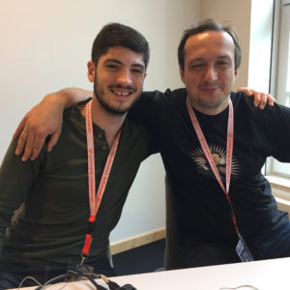

Previously
2017, Hannover Sliding Windows: Microsoft 3.0 With Joey Aiello & Bartosz Bielawski http://slidingwindows.de/slw07/
2018, Hannover The X factor, with Bartosz Bielawski
Notes:
# My podcast (German / English)
https://www.slidingwindows.de
# Feed URIs
http://www.slidingwindows.de/?feed=slw-aac
http://www.slidingwindows.de/?feed=slw-mp3
# My conferences hub
https://github.com/thorstenbutz/conferences
Photo taken by Thorsten Butz.

Slide 3
dev
ops

Slide 4
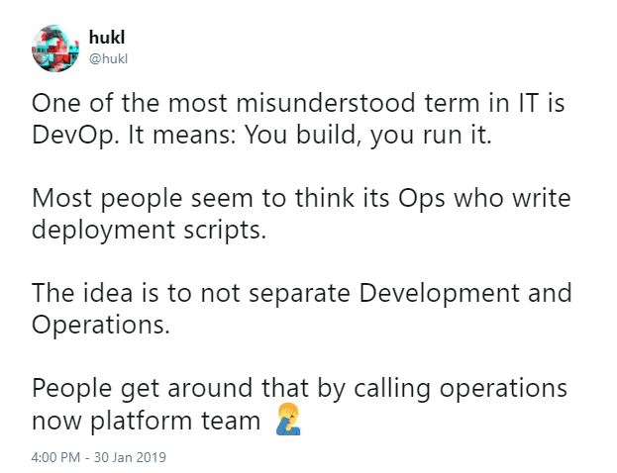
dev
ops
Notes:
https://twitter.com/hukl/status/1090625881805148161

Slide 5
This Session
PwSh: 1st impressions as seen by a "mere mortal"
Administering Windows Server with MacOS
#wtf ...

Slide 6
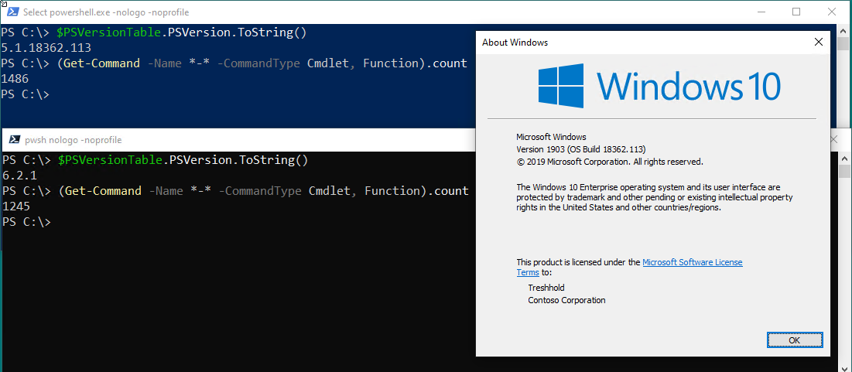
Never mind the shell ...

Slide 7
PwSh: “first impressions”
Notes:
More about file system access:
Chasing the seconds: Optimizing file enumeration(Oyvind Kallstad)
https://www.youtube.com/watch?v=erwAsXZnQ58&t

Slide 8
Get-Command
 | W10 1803 |  | W10 1809 |  | W10 1903
PoSh 5.1 | 1455 |  | 1497 |  | 1486
PwSh 6.2.1 | 375 |  | 1162 |  | 1245
(Get-Command -Name *-* -CommandType Cmdlet, Function).count

Slide 9
BuiltIn Cmdlets + RSAT
 | W10 1803 |  | W10 1809 |  | W10 1903
PoSh 5.1 | 1455 | 2704 | 1497 | 2787 | 1486 | 2795
PwSh 6.2.1 | 375 | 375 | 1162 | 1486 | 1245 | 1793
(Get-Command -Name *-* -CommandType Cmdlet, Function).count

Slide 10
SSHd configuration WS 2019*
Add "windows capability" from FOD iso or online
Start-Services: sshd, ssh-agent
Check Firewall (should be configured by setup)
Add default shell via Registry
Add subsystem “powershell” to sshd_config
* also applies to Win10-1809 and, probably, later releases

Slide 11
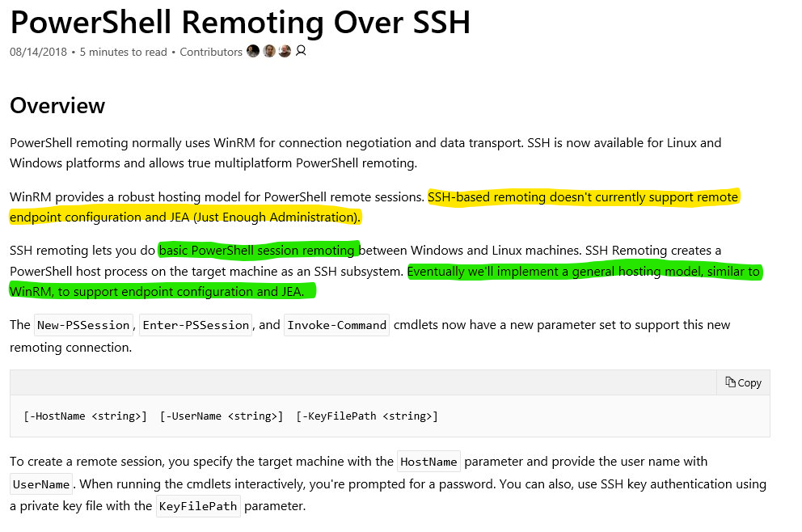
Not yet complete

Slide 12
Call me a hipster:
Managing AD from MacOS

Slide 13
Finally, the boss fight:
Microsoft Exchange

Slide 14
dev
ops
Create Stuff Buy products
Open Source Maintenance
Agile development Evolution
Minimzed OS Full GUI servers
SSH, WSMan RDP
Alway online Often offline
Always current Legacy software

Slide 15
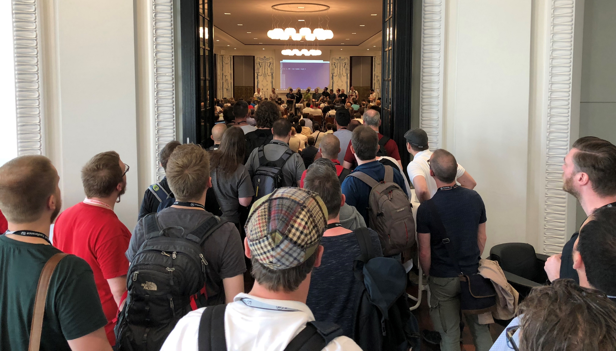
Notes:
Photo taken by Thorsten Butz.

Slide 16
One more thing ?

Slide 17
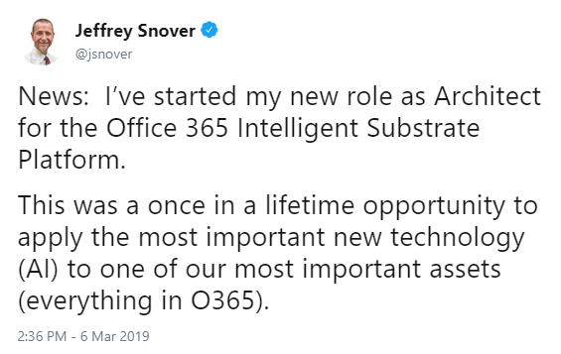
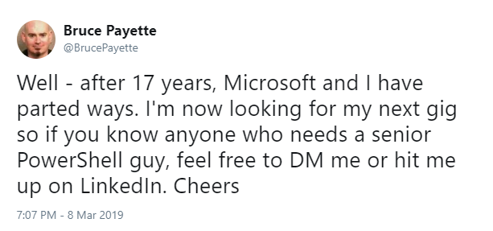
The Revolution devours its own children?
parents
Notes:
Original quote by Georg Büchner in "Dantons Tod", 1835
„Ich weiß wohl – die Revolution ist wie Saturn, sie frißt ihre eigenen Kinder.“

Slide 18
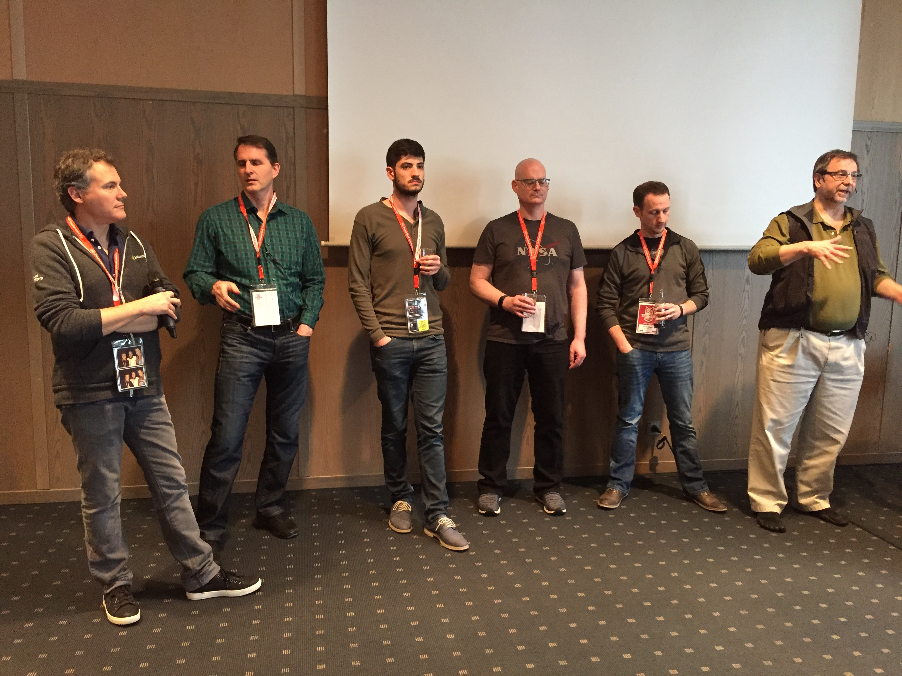
PSConfEU 2017: PowerShell Team AMA
Notes:
Photo taken by Thorsten Butz on Mai 7, 2017
Angel Calvos
Keith Hansen
Joey Aiello
Bruce Payette
David Wilson
Jeffrey Snover

Slide 19




2019
Notes:
Angel Calvos: AWS
Keith Hansen: AWS
Joey Aiello
Bruce Payette: Leaving Microsoft (March 2019)
David Wilson: Github
Jeffrey Snover: New role: Architect for the "Office 365 Intelligent Substrate Platform" (March 2019)
Hemant Mahawar, May 2019:
https://twitter.com/HemanMahawar/status/1123665053230592001

Slide 21

about_Speaker
{
"Speaker" : "Thorsten Butz",
"Uri" : "thorsten-butz.de",
"Twitter" : "thorstenbutz",
"Podcast" : "slidingwindows.de"
}

